Slide 1
ICS102 Project for 183
By: mohammed almazyad and omar alqarni

Slide 2
Binary Operations Class

Slide 3
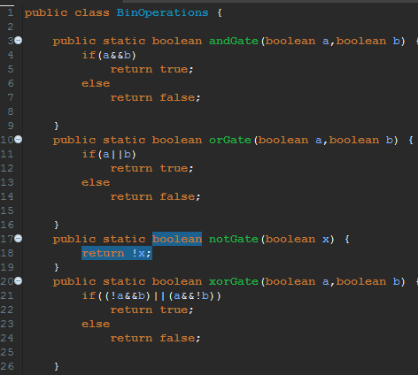




Binary Operations Class

Slide 4
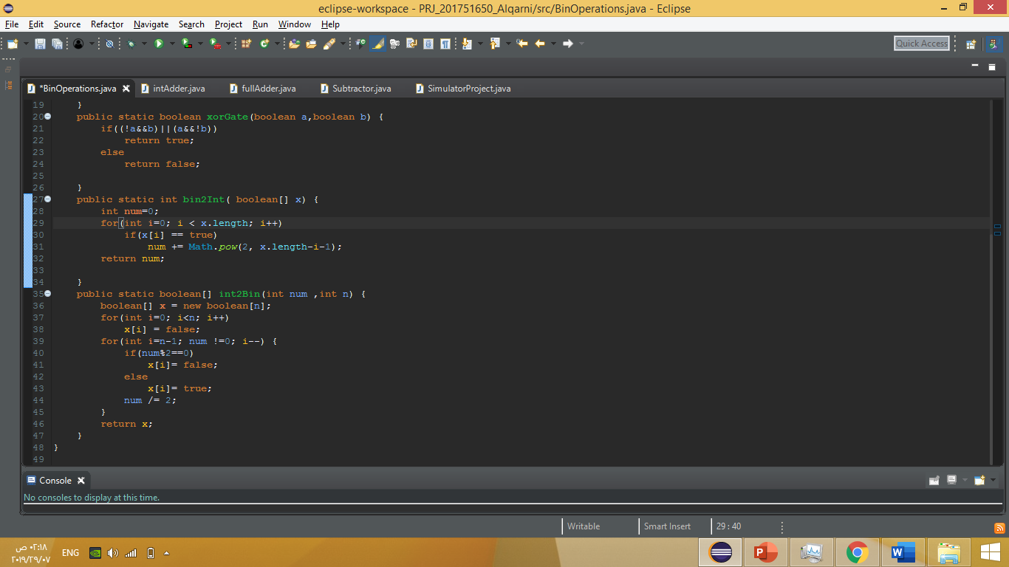
Binary Operations Class

Slide 5
Integer Adder Class

Slide 6
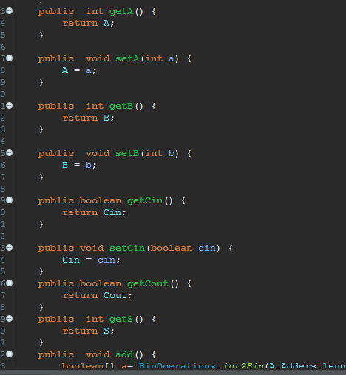
Integer Adder Class

Slide 7
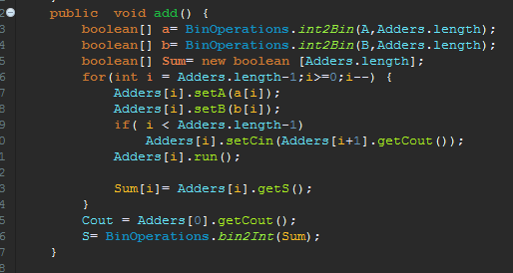
Integer Adder Class

Slide 8
Full Adder Class

Slide 9
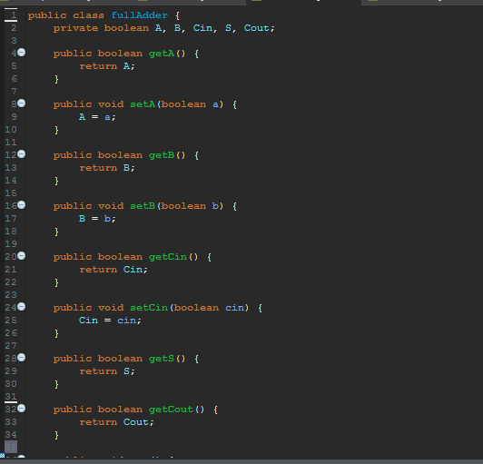
Full Adder Class

Slide 10
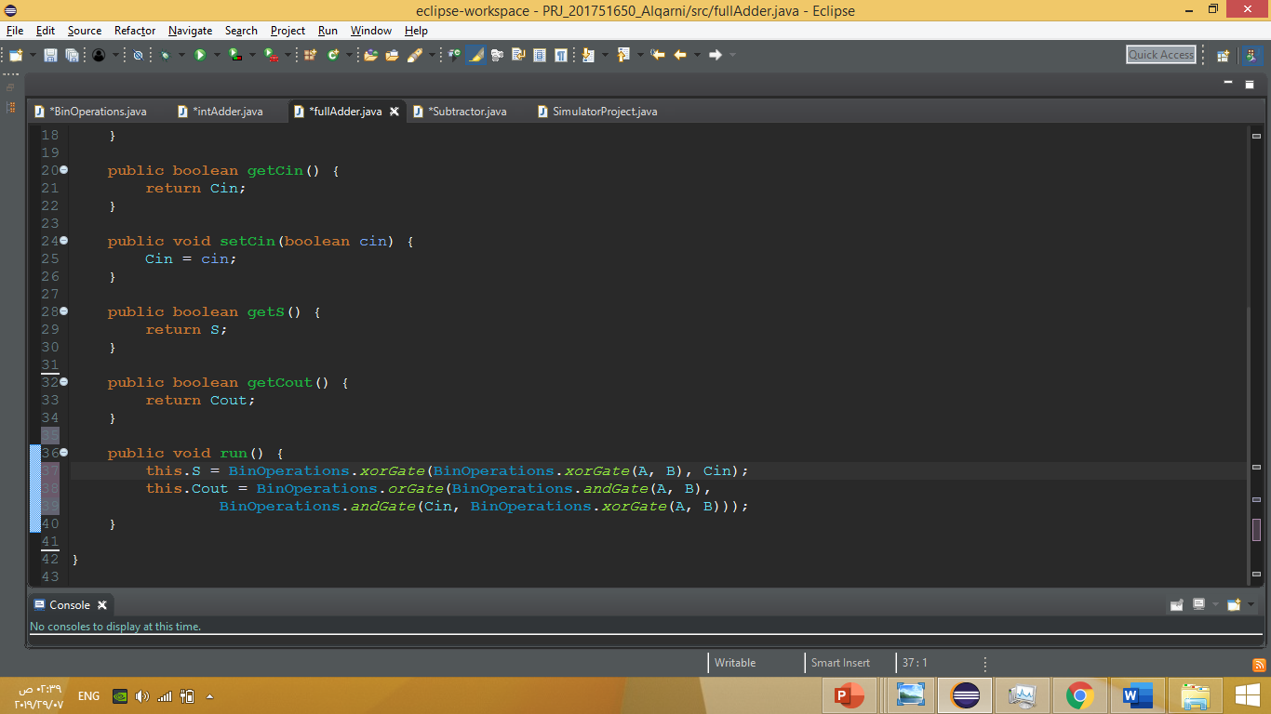
Full Adder Class

Slide 11
Subtractor Class

Slide 12
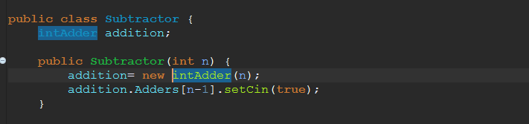
Subtractor Class

Slide 13
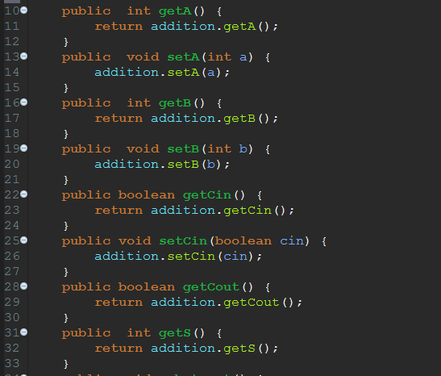
Subtractor Class

Slide 14
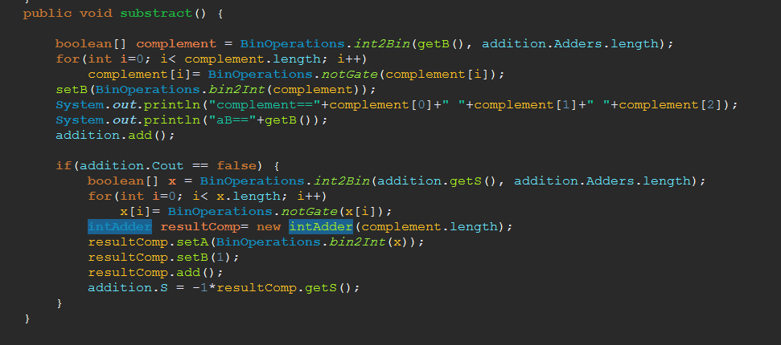
Subtractor Class

Slide 15
The Main Method

Slide 16
The Program Execution.

Slide 17
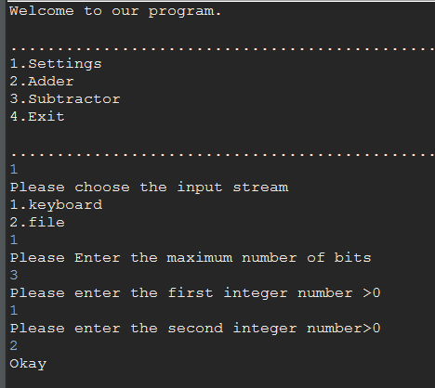
Addition procedure Using The Keyboard

Slide 18
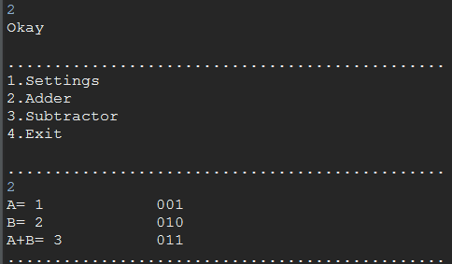
Addition procedure Using The Keyboard

Slide 19
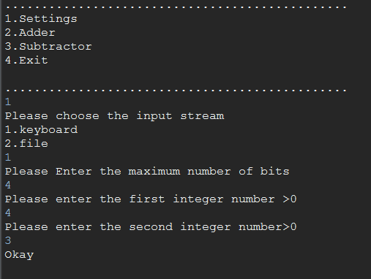
Subtraction procedure Using The Keyboard

Slide 20

Subtraction procedure Using The Keyboard

Slide 21
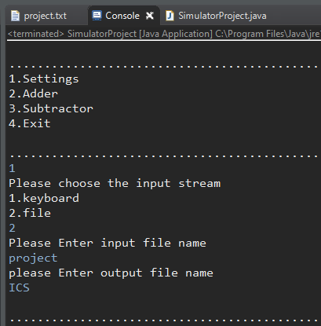
Addition procedure Using File I/O

Slide 22

Addition And Subtraction procedure Using File I/O

Slide 23
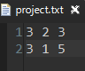
Addition And Subtraction procedure Using File I/O

Slide 24
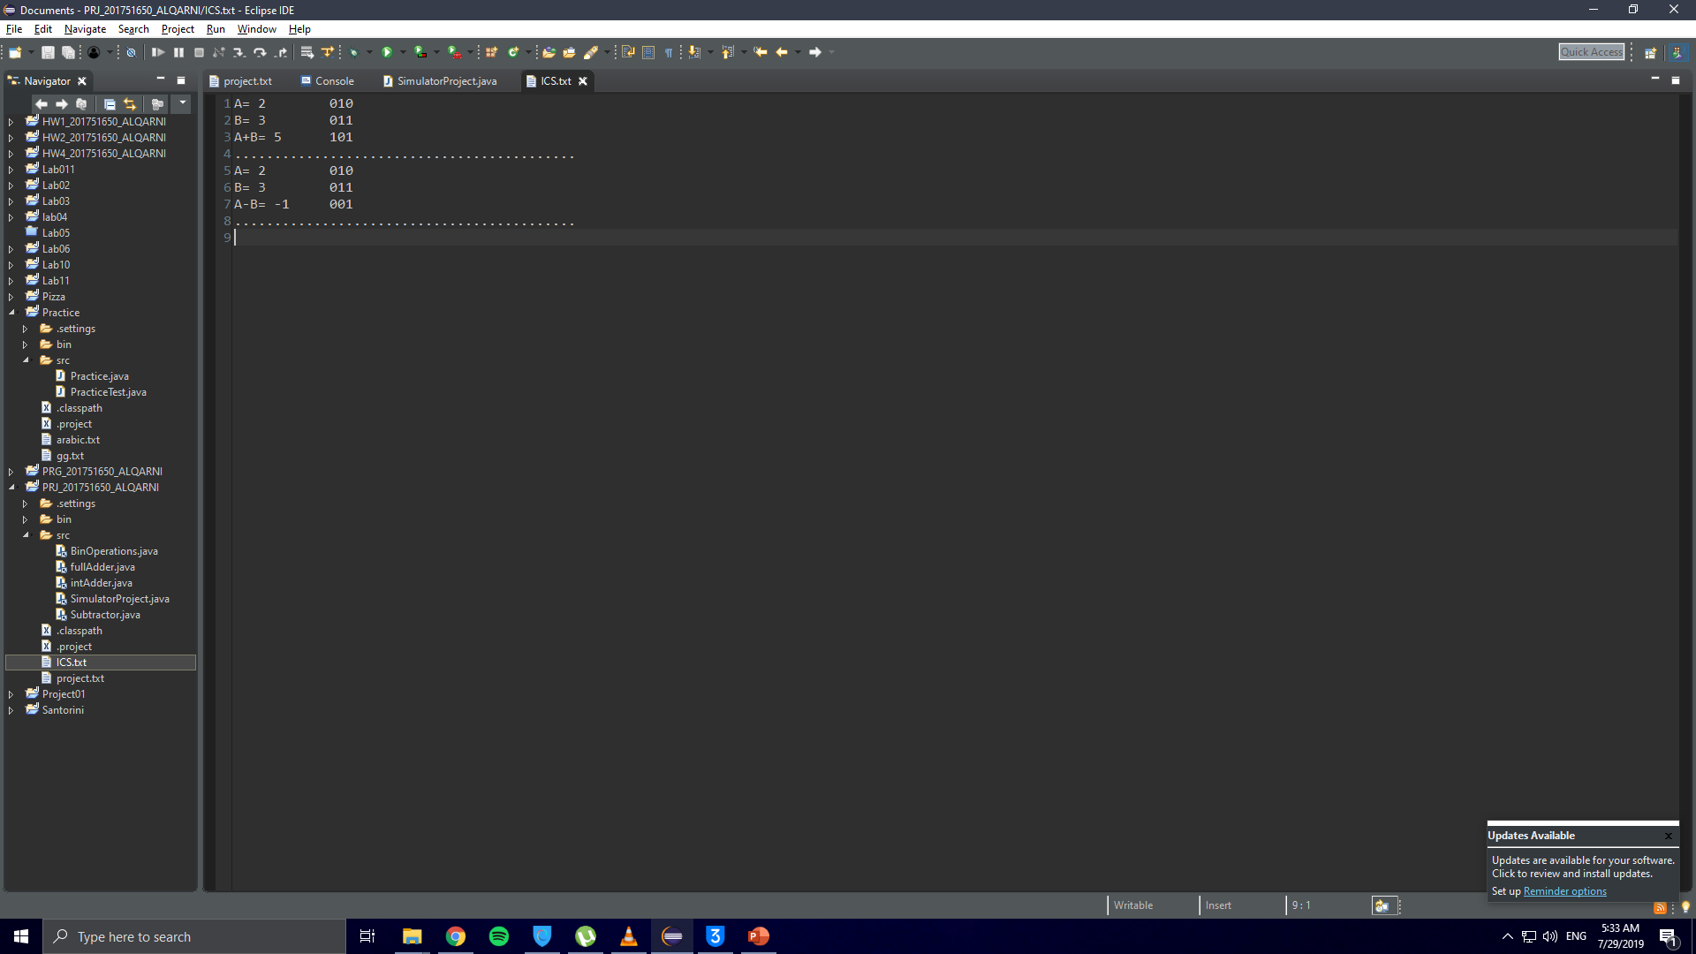
Addition And Subtraction procedure Using File I/O

Slide 25
Q&A

